Slide 1
Developing a Problem Statement
Foundation of the study design
Must be defined in a format that allows for successful study
Dictates the concepts and methods used to collect the data
Determines the context in which the conclusion will be interpreted
What is the question to be answered?
Keep it simple

Slide 2
The Research Question
Keep it simple
Given a problem, what can be done, or what approach should be taken to improve it?
What is known about the problem?
What is not known about the problem?
What information or data are needed to improve the situation?

Slide 3
Formats to Ask the Question
Null Hypothesis format
  There are no differences as a result of implementing a procedure among the experimental groups
Alternative hypothesis format
  There is a difference as a result of implementing a procedure among the experimental groups
Research question format
  Asks if there is a difference as a result of implementing a procedure among the experimental groups

Slide 4
Which Format to Use?
Research question
  Broad, can be used for most studies
Null and alternative hypothesis
  Stronger in their specificity and better define the relationship between variables
  Require a statistical analysis
All variables need to be identified
  Independent, dependent, nuisance
Variables need to be measurable

Slide 5
Stating the Research Question
Null Hypothesis | Alternate (Directional) Hypothesis | Research question
No relationship between the variables | There is a relationship (+ or -) between the variables | A question that needs to be answered
“There is no effect of Xopenex on change in FEV₁ beyond that of generic albuterol in patients with moderate COPD” | The use of a ventilator bundle in intubated, mechanically-ventilated patients, including oral care, sulcrafate, and positioning decreases the incidence of airway-associated pneumonia, versus the incidence in a control group not receiving the ventilator bundle. | What are the opinions of baccalaureate versus associate degree respiratory therapy students on reading and interpreting the medical literature as a practice-change agent?

Slide 6
Narrowing the Focus of the Question
Problem statement
Question (problem converted into a question that can be answered)
Aim/purpose of the research project
Objective (what the researcher will do to answer the question); most specific

Slide 7
Question Ideas
What are the physiologic effects of _________?
Does this _______ function as the manufacturer says it will?
If I change this parameter on the ventilator, what effects will it have?
Is this therapy effective to decrease length of stay or the cost of hospitalization compared to the other therapy?
If I use this new ________, is the outcome improved over the previous model?

Slide 8
Be sure your problem statement is very precise
Imprecise: Does the patient do better after we use a spacer with his MDI?
Precise: In children 5-11 years old, is there a significant improvement in peak flow following albuterol MDI use with a spacer versus not using a spacer?

Slide 9
What are variables?
Manageable number of questions
Target variable is dependent (FEV1)….
The results of changing the independent variable (Bronchodilator)

Slide 10
Samples and Populations
Population: entire collection of cases as defined by a set of criteria
Accessible population: the population available to the investigator
Target population: the population to which the research results are intended to be generalized

Slide 11
Sample
Samples are used to save time and money
Measurements from a sample can be generalized to the target population
Important to assure that the sample represents the target population

Slide 12
Sampling Rules
Populations are defined by the researcher and must be clearly specified
Populations need not be large in number
Accessible population must be clearly described, since the accessible population determines the true target population
Sample size effects the precision of estimates. Correct sample size increases the probability for correct research conclusions even with small sample sizes

Slide 13
Sampling Methods
Non probability samples: non-random sampling, convenience or accidental sample
  The first 20 cases that meet inclusion criteria
Probability sampling: based on random selection; essential for the use of inferential statistics to test hypotheses
  Relies on methods of random sampling

Slide 14
Methods of Random Sampling
Simple random sampling
  every unit in the population has an equal chance of being selected
  number every unit in the population, then use a table of random numbers
Stratified sampling
  used when the population needs to be subdivided
Systematic sampling
  random sample where the population is N and the desired sample size is n and the sample interval is K, the sample size is N/n, and the sample is randomly started at K
Cluster sampling: random selection of intact groups within a population of groups

Slide 15
Design or Experimental Validity
Internal
  Limiting or controlling factors and events other than the independent variable
    Even distribution of extraneous variables
External
  Factors effecting the generalizability of the data
    Addressing only the research question
    Don’t stray by inferring that your results effect subjects other than those included in your study
      Animals to humans
      One age group to another
      In vitro to in vivo

Slide 16
Threats to Internal Validity
Threats that effect the validity of the study itself
  Temporal
    History: passage of time; maturation: the subject ages and can do things better because they are older, attrition: subjects prematurely leave the study
  Measurement
    Testing: repeated testing may allow the subject to become test-wise
    Instrumentation: Problems with measurement instruments
    Sampling error: representativeness of the population, number, randomization
    Regression to the mean: tendency of outliers to move towards the mean

Slide 17
Threats to External Validity
Threats related to the population used
  The sample is different from the population to which one wishes to generalize
  Subject-treatment interaction
    Confounding effects of the subjects’ attributes on the dependent variable
    Genetic makeup, lifestyle, severity of illness, mental ability, psychomotor skill
  Carefully sample from the population
  Select-out confounding features by being specific with inclusion and exclusion criteria

Slide 18
Concepts of Research Design
 Variable: an entity that can take-on different values; that
which is measured to determine changes that answer the
research question or address the hypotheses
 pressure, volume, flow, opinion, scores on anything
 Independent variable: the variables that is manipulated, aka
treatment variable
 Dependent variable: a variable that is measured, that may
change as a result of the treatment
 Nuisance variables: extraneous variables that are difficult to
control that can effect the dependent variable
 Placebo: a fake or sham treatment


Slide 19
Experimental Designs
Conventions for an experimental design
R=randomization
M=matched
X, with or without subscript=treatment
X_{O}=no treatment or placebo
O=measurement or observation
Dashed line=nonequvalency

Slide 20
True Experimental Designs: 3 Characteristics
Manipulation of an independent variable
Control of extraneous variables
  random selection of sample and random assignment to groups: random or chance assignment can be expected to even-out nuisance variables
  matching of subjects between groups or grouping of subjects based on a nuisance variable: subjects are used as their own controls
  inclusion of a nuisance variable as a treatment (independent) variable
  statistical removal of a nuisance variable through analysis of covariance
Observation of a change in the dependent variable

Slide 21
Pre-experimental Designs
Weak and subject to threats
Lack a control group
Sensitive threats to temporal validity
Poor generalizability

Slide 22
Pre-experimental Designs
One-shot case study
  XO
  Treatment is given and a measurement is made
  Typical of surveys
  Teach a class, give a test
  Descriptive studies

Slide 23
Pre-experimental Designs
One group pretest-posttest
OXO
Make a measurement, give a treatment, remeasure
Vulnerable to temporal threats to internal validity
Difficult to generalize because the group may not be representative (not randomized)

Slide 24
Pre-experimental Designs
Static group comparison
XO
_ _ _ _
O
1 Group has received a treatment, the other no treatment
Not randomized, therefore the groups are not equivalent
Some factor other than the treatment may cause the results

Slide 25
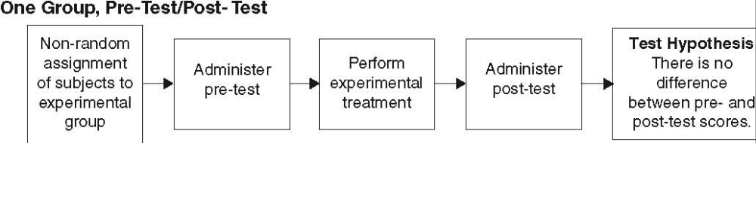
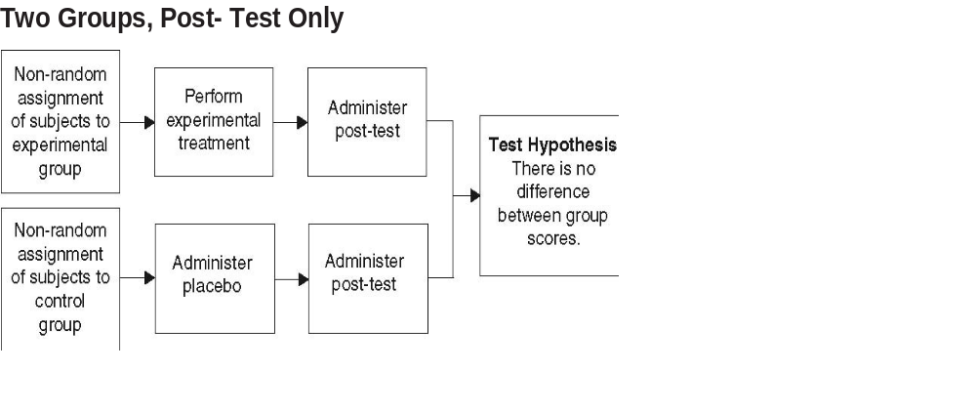
Pre-Experimental Designs

Slide 26
True Experimental designs
Randomization
Control group
Independent variables are manipulated
Confounding variables are equally distributed
  Ttests and other tests of equivalency show no difference between groups in these traits

Slide 27
True Experimental Designs
Pretest, posttest, control group design
R O₁ X_{O} O₂
R O₁ X₁ O₂
Rules-out most threats to internal and external validity
“gold standard” for RCTs
Control group is either no treatment, a placebo, or the conventional or “predicate”
Subjects often blinded

Slide 28
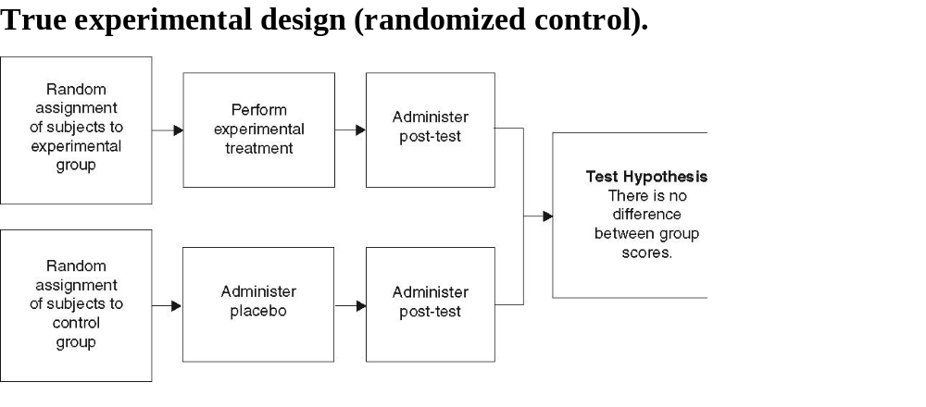
True Experimental Design

Slide 29
True Experimental Designs
Posttest only control group design
R X_{O} O
R X₁ O
Pretest is inappropriate or unavailable

Slide 30
True Experimental Designs
Solomon four group design
R O₁ X_{O} O₂
R O₁ X₁ O₂
R X_{O} O₂
R X₁ O₂
Combination of two previous designs
Determines if the effect occurs due to the pretest
Requires twice as many subjects

Slide 31
Quasi-experimental Designs
More rigorous than pre-experimental designs
Not as rigorous as true experimental designs
Lack one or more of the characteristics of a true experimental design
  Randomization, manipulation of independent variable, control group

Slide 32
Quasi-experimental designs
Nonequivalent control group design
  Groups are not randomized
  O₁ X_{O} O₂
  O₁ X₁ O₂
Separate sample pretest-posttest design
O X
_ _ _
X O
Used when the pretest may bias the results

Slide 33
Quasi-experimental Designs
Time series
O₁ X_{O} O₂ O₃ O₄
O₁ X₁ O₂ O₃ O₄
Groups are compared to each other and there are multiple subsequent measurements of the dependent variable
Repeated testing threatens validity
Groups may be nonequivalent

Slide 34
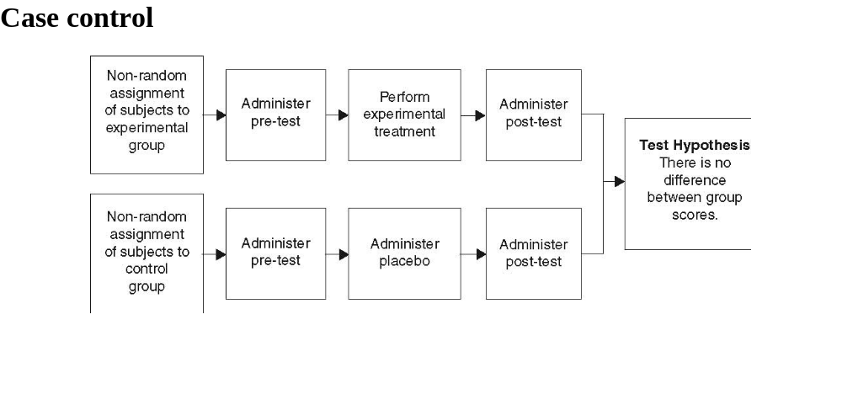
Quasi-experimental

Slide 35
Nonexperimental Study Designs
Retrospective Studies
Reason from a present effect, or consequence in a population, back to antecedent causes
May be used to determine causes or risk factor for a disease
Data are collected from one point in time backwards

Slide 36
Nonexperimental Study Designs
Prospective Studies
Reason from a present antecedent or event in a population to future consequences or effects
A group followed prospectively is called a cohort
Data are collected from one point in time forward

Slide 37
Nonexperimental Study Designs
Case Studies
Study of one interesting, unusual, or rare case for instructional purposes about that problem

Slide 38
Nonexperimental Study Designs
Surveys
Written or oral questionnaires
Best to choose survey subjects randomly
Problems are response rate and self selection bias
Very important to phrase questions so only one question is being asked
Pilot test
Cover letter

Slide 39
Nonexperimental Study Designs
Correlational Studies
Presence and strength of a relation between two variables
Correlation means that two variables co-vary, but does not imply causality

Slide 40
What is EBM?
EBM is an approach to practice and teaching that integrates pathophysiologic rationale, caregiver experience, and patient preferences with valid and current clinical research evidence. Most of the weight is given to the results of rigorous research.

Slide 41
To practice EBM:
Practitioners change their way of thinking about clinical problem solving
Place a lower value on authority unsupported by empirical evidence
Decision making requires careful examination of the evidence
Uses a set of formal rules, applied in an explicit manner
Requires the judicious application of research findings in the patient context
Requires a sense of the availability of resources, and an understanding of the values of those involved in the clinical decision

Slide 42
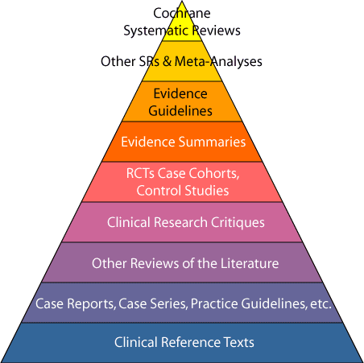
Hierarchy of Evidence

Slide 43
Cochrane Database for Systematic Reviews
Gold standard for use in EBM
Rigorous process for identifying studies to include
Evaluates study strengths and weaknesses
5,000 reviews and 2,000 protocols
EBM/EBP databases: USA Biomedical Library
Evidence based healthcare EBM/EBP databases Cochrane Library

Slide 44
Meta Analysis
Summations of similar studies to draw a unified conclusion
Strongest when the studies are RCTs
Quantitative method
Four step method: literature review, calculation of effect size for each study, determination of a composite effect size, calculation of a failsafe number to assess the certainty of composite size

Slide 45
Randomized Clinical Trials
Random assignment of patients
Increased sample size increases the strength of the argument
Blinding further increases the strength of the treatment
Typical drug study

Slide 46
Systematic Reviews of Observational Studies
Patients are allocated based on their or the clinician’s preference
Blinding is not possible
Results of these studies often coincide with the results of RCTs
Oxygen therapy during exercise increased exercise tolerance and dyspnea in COPD

Slide 47
The Process of EBM Research
Formulating the Question
  pertinence to your practice
  process relies on a clear question (PICO)
  focus the question on the patient’s needs

Slide 48
PICO
Patient or problem
Intervention, prognostic factor, or exposure
Comparison
Outcomes

Slide 49
Gathering the Evidence
EBM reviews-ACP Journal Club
  www.acponline.org
Clinical Evidence
  www.clinicalevidence.org
Cochrane Library
  www.cochranelibrary.com
Medline at OVID
Agency for Healthcare Research and Quality
  www.ahrq.gov
Evidence-based Guidelines
  http://www.rcjournal.com/cpgs/

Slide 50
EBM Metrics for a Diagnostic Test
True/false positives and negatives
Specificity and sensitivity
Likelihood ratio
Positive and negative predictive value
Diagnostic accuracy

Slide 51
True/false positives and negatives
True positive: reference standard and test result are positive
True negative: reference standard and test result are both negative
False positive: test result is positive, but reference standard is negative
False negative: test result is negative, but reference standard is positive

Slide 52
Sensitivity and Specificity
Sensitivity: the ability of a test to correctly identify patients with the condition of interest.
  “If the patient has the condition, how likely is she to have a positive test?”
Specificity: the ability of a test to correctly identify patients who do not have the condition.
  “If the patient does not have the condition, how likely is she to have a negative test?”

Slide 53
Likelihood Ratio
Likelihood that a positive diagnostic test would be expected in a patient with a disorder of interest compared to the likelihood that the same result would be expected in a patient without the condition
1 means no difference
>1 increases the probability that the target condition is present
< decreases the probability that the condition is present

Slide 54
Positive and Negative Predictive Value
Positive predictive value is the probability that the condition of interest is present when the test is positive
Negative predictive value is the probability that the condition of interest is absent when the test is negative
These values are effected by the prevalence of the condition of interest, unlike sensitivity and specificity

Slide 55
Diagnostic Accuracy
The proportion of correct results out of all results
Expressed as a percentage or decimal

Slide 56
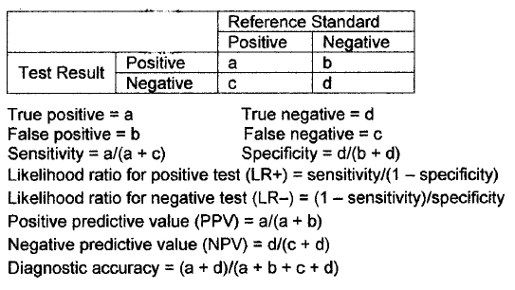
EBM Metrics for Diagnostic Tests

Slide 57
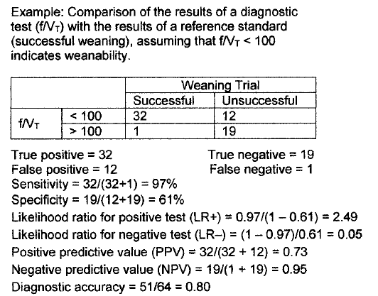

Slide 58
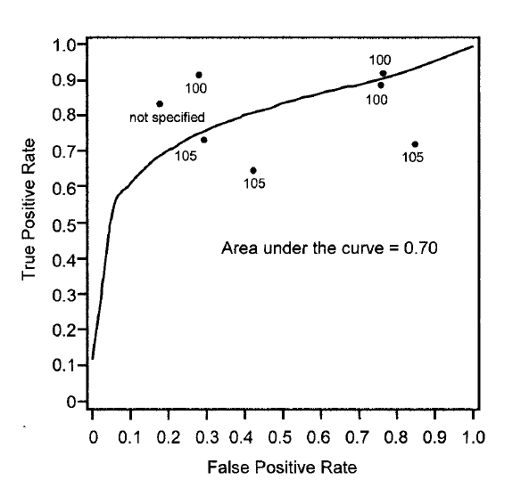
EBM metrics for a diagnostic test
Receiver Operating Curve (ROC): plots the true positive rate against the false positive rate over a range of cutoff values
ROC for the RSBI

Slide 59
EBM metrics for a Therapy
Controlled event rate
Experimental event rate
Relative risk
Relative risk reduction
Absolute risk reduction
Number needed to treat
Odds ratio

Slide 60
EBM Metrics for a Therapy
Controlled event rate: proportion of patients in the control group in whom the event is observed
Experimental event rate: proportion of patients in the experimental group in whom the event is observed
Relative risk: ratio of the risk of an event in the experimental group to that in the control group
  <1 indicates a benefit from the intervention
  >1 indicates harm from the intervention
  1=no effect of the intervention
  If the associated CI does not include 1, it is statistically significant

Slide 61
EBM metrics for a Therapy
Relative risk reduction: estimate of the proportion of baseline risk that is removed by the therapy
Absolute risk reduction: difference in the absolute risk (% of patients with an outcome) in the experimental event rate versus the control event rate
Number needed to treat: number of patients who need to be treated to prevent one bad outcome

Slide 62
EBM metrics for a Therapy
Odds ratio: the ratio of the odds in the experimental group to the odds of the same event in the control group
  OR = 1 means there’s no difference
  OR > 1, the rate of the event is increased in patients exposed to the risk factor
  OR < 1, the rate of the even is reduced
  If the CI of the OR includes 1, it is not significant, because the OR may be 1 indicating no difference

Slide 63
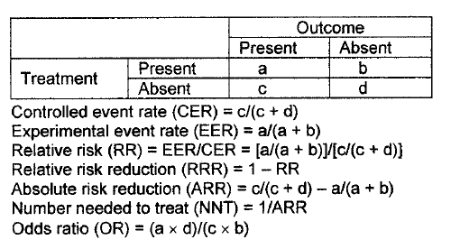

Slide 64
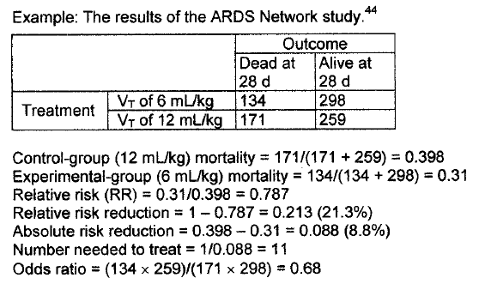

Slide 65
Investigate the Feasibility of Your Proposed Study
1. What is the significance or potential benefit of knowing the answer? So what?
2. What are the variables and are they measurable?
3. How long will the project take and how much time do you have?
4. Are there patients, animals, or devices available?
5. Where will equipment and funding come from?
6. Do you have the knowledge and experience to do this project?
7. Is your project ethical?

Slide 66
Evidence-based practice
Evidence-Based Practice (EBP) requires that decisions about health care are based on the best available, current, valid and relevant evidence. These decisions should be made by those receiving care, informed by the tacit and explicit knowledge of those providing care, within the context of available resources.
Dawes, M., Summerskill, W., Glaszion, P., Cartabellotta, A., Martin, J., Hopayian, K. et al. (2005) Sicily statement on evidence-based practice. BMC Medical Education, 5. Retrieved 7/22/09 from http://www.biomedcentral.com/1472-6920/5/1

Slide 67
Evidence Pyramid
Start at the top and work your way down.
Meta-analysis/Metasynthesis
Systematic Review
Randomized Controlled Trial
Cohort Studies
Case Control Studies
Case Series/Case Reports
Animal Research

Slide 68
Healthcare Literature
Primary – original research
  Experimental (an intervention is made or variables are manipulated)
    Randomized Control Trials
    Controlled trials
  Observational (no intervention or variables are manipulated)
    Cohort studies
    Case-control studies
    Case reports
Secondary – reviews of original research
  Meta-analysis/Metasynthesis
  Meta-synthesis
  Systematic reviews
  Practice guidelines
  Reviews
  Decision analysis
  Consensus reports
  Editorial, commentary
Not used in EBP

Slide 69
Levels of Evidence
Type of Evidence
I. Meta-analysis of multiple well-designed controlled studies.
II. Well-designed experimental studies.
III. Well-designed, quasi-experimental studies, such as nonrandomized controlled, single-group pre-post, cohort, time series, or matched-case controlled studies.
IV. Well-designed nonexperimental studies, such as comparative and correlational descriptive and case studies.
V. Case reports and clinical examples.
Strength and Consistency of Evidence
A. There is evidence of type I or consistent findings from multiple studies of types II, III, or IV.
B. There is evidence of types II, III, or IV, and findings are generally consistent.
C. There is evidence of types II, III, or IV, but findings are inconsistent.
D. There is little or no evidence, or there is type V evidence only.
Panel Consensus: Practice recommended based on the opinions of experts in pain management.

Slide 70
Searching for evidence
  Twenty-one percent of all patients with COPD are readmitted within 30 days of discharge,^{1,2} and costs for these readmissions are 18% higher than for initial stays.¹ This high prevalence and cost make COPD an important target of Centers for Medicare and Medicaid Services (CMS) policies designed to reduce readmissions. Thus far, the CMS strategy for reducing readmissions has focused primarily on incentivizing improvements in inpatient care and discharge planning. For example, the Hospital Readmission Reduction Program penalizes hospitals with higher than expected rates of readmission for specified conditions. These inpatient-focused strategies have not produced consistent reductions in readmissions.
Databases and other sources to search:
  Dynamed
  Clinical Key
  Cochrane Library
  PubMed
  CINAHL
  Scopus

Slide 71


Intent of Belmont Report
Autonomy
Beneficence
Justice
This is important.
It’s in every lecture on human subjects.
Notes:
Ethical principles of the Belmont Report

Slide 72
  Belmont Report [Principles]
  Respect for Persons
  Beneficence
  Justice
    Federal Regs
    [Applications]
  Informed consent
  Assessment of Risks and Benefits
  Selection of subjects
Notes:
The Belmont Report PRINCIPLES and corresponding APPLICATIONS
-–
(1) respect for persons – informed consent & extra protect/ for certain grps.
(2) beneficence – risks should not outweigh benefits. Do no harm
(3) justice – selection of subjects should be equitable.
As a researcher or study coordinator, there are a few questions to ask yourself when engaging in what you feel may be “human subjects research.”

Slide 73

Who Has IRB Oversight?
Regulatory Oversight:
Department of Health and Human Services (DHHS) 45 CFR 46 – COMMON RULE
Food and Drug Administration (FDA) 21 CFR 50 and 21 CFR 56
Office for Human Research Protections (OHRP)
Federal Wide Assurance (FWA)
Notes:
In 1981 as a direct result from the Belmont Report, the DHHS and FDA issues regulations.
The other major player is the FDA – oversee all investigations involving drugs/biologics/ or devices.
Use in clinical research settings – protect subjects as well as produce sound data
Basically you have two sets of rules – most are the same, some differences in applicability.
Nutshell – federal guidelines were directly derived from the ethical principles we have reviewed. Both the Common Rule and the FDA regulations provide protections for human subjects in research and mandate IRB oversight of such research.
The common rule is enforced by OHRP – used to be called OPRR until about 3 yrs. Ago it was taken out from under NIH and now reports to the sec. of DHSS – new director, more
money, more people.
FWA – agreement to abide by the OHPR regs. – states how we will protect the welfare of res. Subjects in accordance to federal policy (common rule).

Slide 74
Vulnerable Populations
Additional regulatory requirements-
  Subpart B: Pregnant Women
  Subpart C: Prisoners
  Subpart D: Children
  Respect for persons require additional protections for persons with diminished autonomy

Slide 75
What is an IRB?
IRBs established by federal government to protect rights and welfare of human participants
IRB review is a specialized process to function as an ethics committee
Responsible for ensuring physical, psychological, and social risks associated with research are commensurate with the importance of the research/knowledge gained

Slide 76
Criteria for IRB Approval
Risks are Minimized (Consistent with a sound research design and does not unnecessarily expose subjects to risk)
Risks are Reasonable in Relation to Benefits
Selection of Subjects is Equitable
Informed Consent will be Sought for Each Prospective Subject
Informed Consent will Be Documented
Research Plan Adequately Provides for Monitoring the Data Collected to Ensure Safety of the Subjects
Research Plan Adequately Protects the Privacy of Subjects and Maintains Confidentiality
When some or all of the subjects are likely to be vulnerable to coercion or undue influence, additional safeguards need to be included in the protocol to protect the rights and welfare of these subjects.
Notes:
Criteria applies to research reviewed by convened IRB or under expedited reviee

